Slide 1
SHOPPING CART
S
S
SALES INSIGHT
ISHOLA SEMIU OLAWALE

Slide 2
S
CONTENT
INTRODUCTION
AIM OF THE PROJECT
DATABASE RELATIONSHIP
REQUESTS

Slide 3
S
INTRODUCTION
SHOPPING CART DATABASE CONTAINS SYNTHETIC DATA BY RUCHI BHATIA FOR ONE OF HIS COURSE AT CARNEGIE MELLON UNIVERSITY.
SHOPPING CART COMPANY GIVES DETAILS ABOUT COMPANY:
CUSTOMERS,PRODUCTS,ORDERS AND SALES.
THE COMPANY HAS THREE PRODUCT TYPES
THE FIRM IS LOCATED AT AUSTRALIA
DATA SOURCE: https://www.kaggle.com/datasets/ruchi798/shopping-cart-database

Slide 4
S
AIM OF THE PROJECT
WE HAVE THE TASK OF RUNNING REQUESTS TO GENERATE INSIGHTS INTO THE COMPANY DATABASE
WE ARE RUNNING SQL QUERIES TO DERIVE MEANINGFUL INSIGHTS ABOUT THE COMPANY.

Slide 5
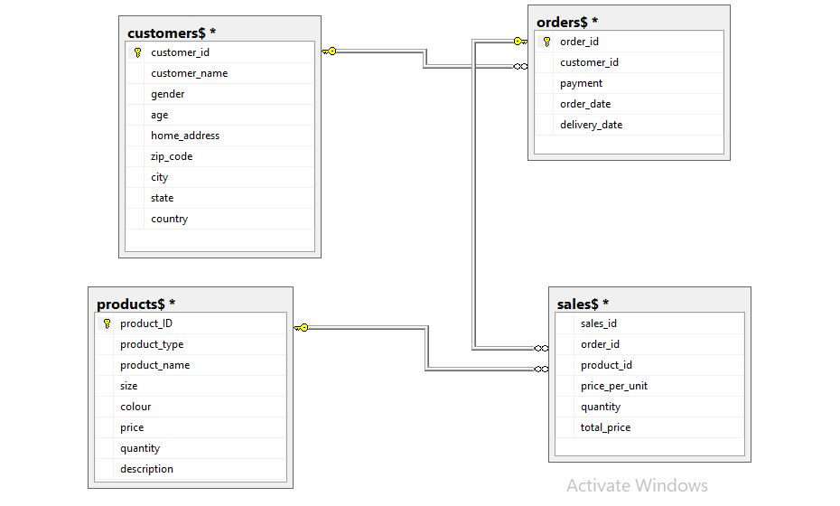
S
DATABASE RELATIONSHIP
1. CUSTOMERS$: CONTAINS CUSTOMERS RELATED DATA
2. ORDERS$: CONTAINS PLACED ORDERS RELATED DATA
3. PRODUCTS$: CONTAINS DATA ABOUT THE DIFFERENT COMPANIES PRODUCTS
4. SALES$: CONTAINS DATA ABOUT THE COMPANY SALES

Slide 6
S
COMPANY PRODUCTS TYPE
SHIRT
TROUSERS
JACKET
PRODUCT TYPE
Camp Collared
Casual Slim Fit
Chambray
Cuban Collar
Denim
Dress
Flannel
Henley
Linen
Mandarin Collar
Oxford Cloth
Polo
Cargo Pants
Chinos
Cords
Cropped
Drawstring
High-Waisted
Joggers
Pleated
Relaxed Leg
Slim-Fit
Tracksuit Bottoms
Wool
Bomber
Cardigan
Coach
Denim
Leather
Parka
Peacoat
Puffer
Pullover
Shearling
Trench Coat
Windbreaker
PRODUCT NAME

Slide 7
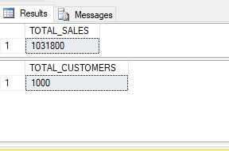
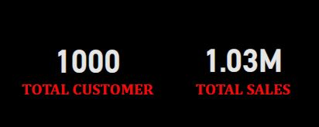
S
REQUEST 1: TOTAL REVENUE AND TOTAL CUSTOMER

Slide 8
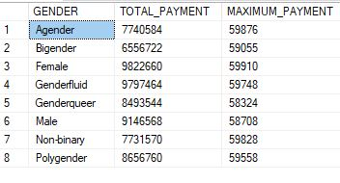
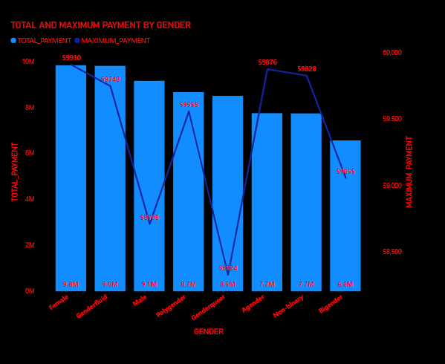
S
REQUEST 2: TOTAL AMOUNT SPENT BY GENDER
INSIGHT: FROM THE VISUAL, IT SHOWS THAT THE TOP 3 GENDERS THAT PURCHASES MOST ARE FEMALE, GENDERFLUID AND MALE RESPECTIVELY. THE MAXIMUM PAYMENT ARE RECORDED BY FEMALE, AGENDER AND NON-BINARY RESPECTIVELY

Slide 9
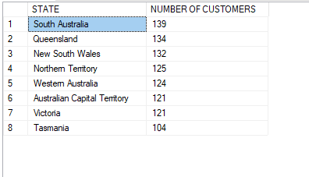
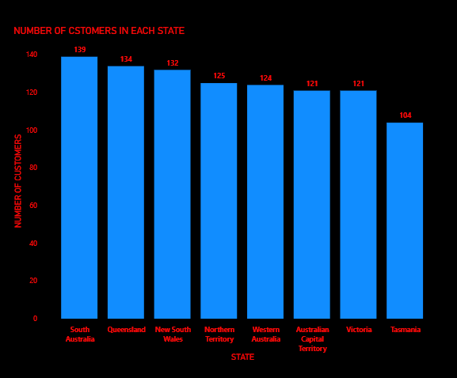
S
REQUEST 3: TOTAL CUSTOMER FROM EACH STATE
INSIGHT: THERE ARE 8 STATES WHERE THE COMPANY HAS CUSTOMERS WITH MOST CUSTOMERS IN SOUTH AUSTRALIA AND LEAST CUSTOMERS IN TASMANIA

Slide 10
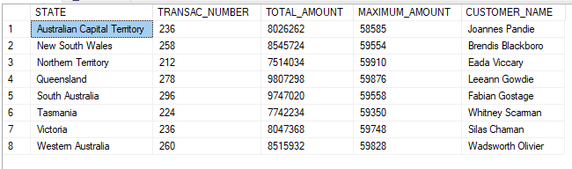
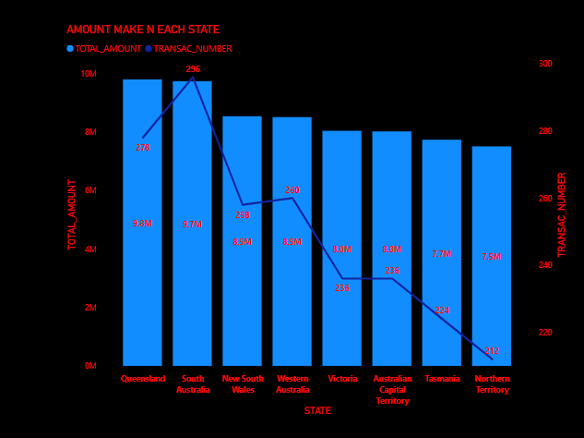
S
REQUEST 4: AMOUNT RECORDED IN EACH STATE
INSIGHT: SALES IN QUEENSLAND, SOUTH AUSTRALIA AND NEW SOUTH WALES ARE VERY ENCOURAGING AND THESE PLACES HAS THE HIGHEST RECORDS OF TRANSACTIONS. WHILE AUSTRALIAN CAPITAL TERRITORY , TASMANIA AND NORTHERN TERRITORY EXPERIENCES ARE PLACES WHERE LOWEST AMOUNT ARE BEING RECORDED.

Slide 11
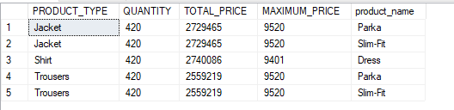
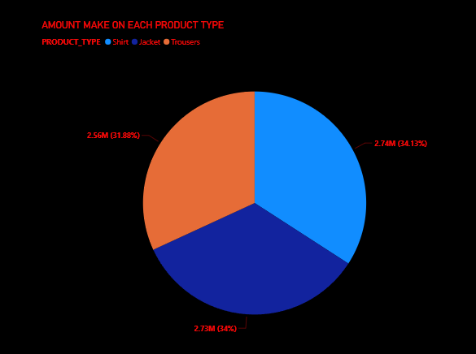
S
REQUEST 5: AMOUNT RECORDED ON EACH PRODUCT TYPE
INSIGHT: THE PRODUCT TYPES ALL HAVE THE SAME QUANTITY SOLD. JACKET HAS PROVIDED THE HIGHEST SALES WITH 9520 MAXIMUM PRICE FROM PRODUCT NAME ‘PARKA’ AND ’SLIM-FIT’. ALSO, SHIRT HAS THE SECOND HIGHEST SALES WITH MAXIMUM PRICE FROM PRODUCT NAME ‘DRESS’ WHILE TROUSERS HAS 9520 MAXIMUM PRICE FROM PRODUCT NAME ‘PARKA’ AND ’SLIM-FIT’

Slide 12
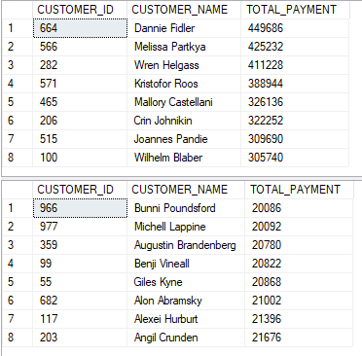
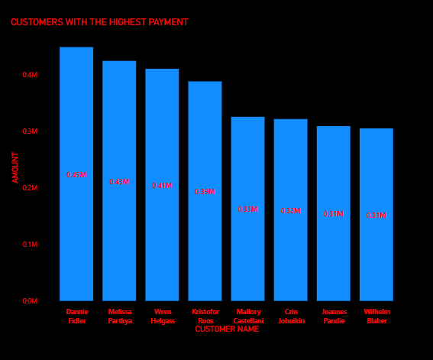
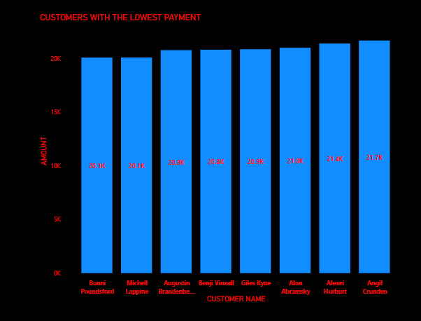
S
REQUEST 6: AMOUNT SPENT BY CUSTOMERS
INSIGHT: THIS SHOWS THE TOP 8 CUSTOMERS THAT HAS THE HIGHEST AND LOWEST AMOUNT SPENT ON THEIR PRODUCTS

Slide 13
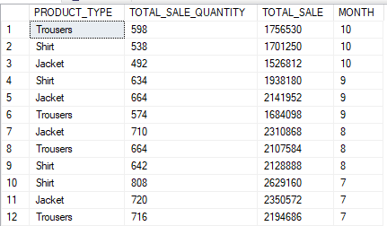
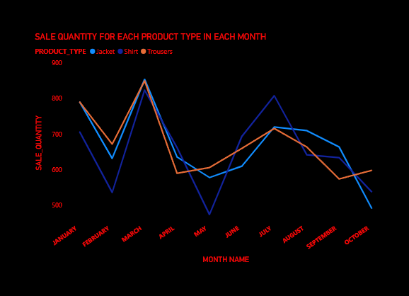
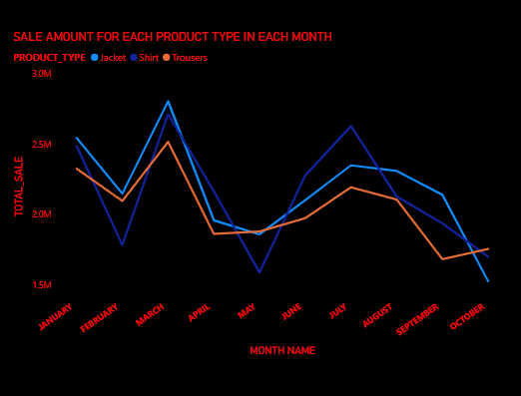
S
REQUEST 7: SALES BY PRODUCT TYPE
INSIGHT: FROM THE TWO CHARTS, WE CAN SEE THAT AN INCREASE IN SALE QUANTITY LEADS TO AN INCREASE IN SALE AMOUNT(REVENUE). IT IS OBVIOUS THAT ALL PRODUCT TYPES HAS MAXIMUM AMOUNT IN MARCH SINCE THE SALE QUANTITY IS MAXIMUM THERE. THE SALES AND REVENUE HAS BEEN DECLINING SINCE AUGUST

Slide 14
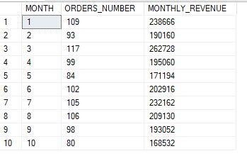
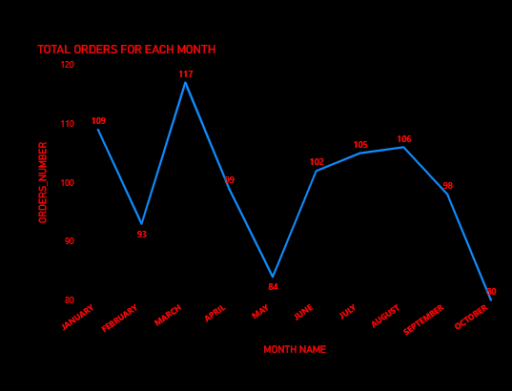
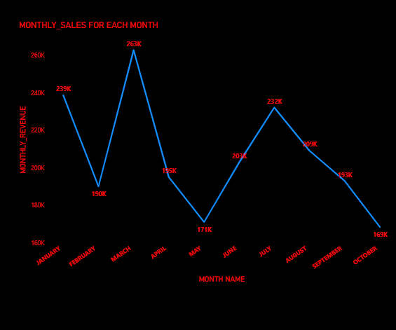
REQUEST 8: TOTAL SALES PER MONTH
S
INSIGHT: MONTHLY SALES INCREASES WITH AN INCREACE IN THE NUMBER OF ORDERS PLACES FOR THE MONTH AND VICE VERSA. IT IS CLEAR THAT SALES HAS BEEN ON THE DECREASE SINCE AUGUST DUE TO CONTINUOUS DECREASE IN THE TOTAL ORDERS FOR THE MONTH.

Slide 15
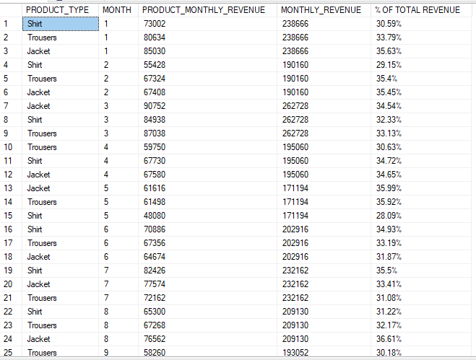
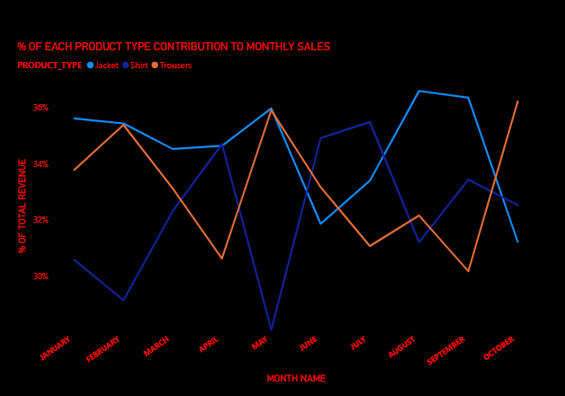
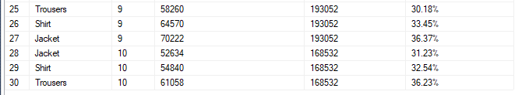
REQUEST 9: CONTRIBUTION OF EACH PRODUCT TYPE TO MONTHLY SALES
S
INSIGHT: THIS SHOWS THE PRODUCT TYPE SALES CONTRFOR EACH MONTH. THE HIGHEST SO FAR FROM JANUARY WAS RECORDED BY JACKET IN AUGHUST WITH 36.61% CONTRIBUTION. IN THE LAST MONTH, SALES OF TROUSERS HAS BEEN ON THE INCREASE MARKING ITS NEW APEX,ALSO SALES OF JACKET HAS BEEN DECLINING.

Slide 16
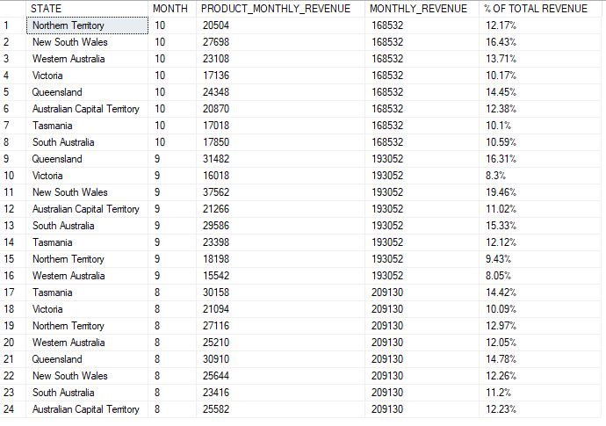
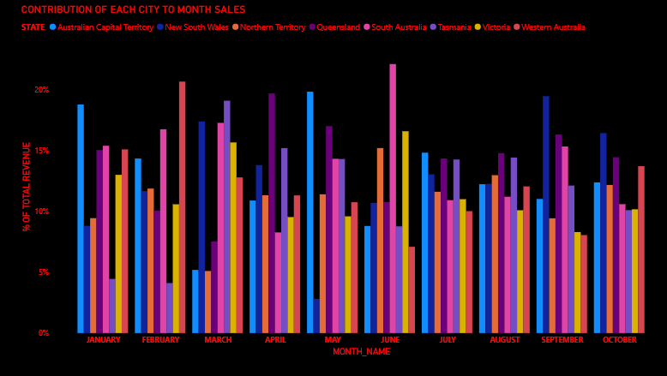
REQUEST 10 : CONTRIBUTION OF EACH STATES TO LAST 3 MONTHLY SALES
S
INSIGHT: THIS SHOWS THE CITIES SALES CONTRFOR EACH MONTH. THE HIGHEST SO FAR FROM JANUARY WAS RECORDED BY SOUTH AUSTRALIA IN JUNE WITH 22.1% CONTRIBUTION. IN THE LAST TWO MONTH THE CONTRIBUTION FROM NEW SOUTH WALES HA BEEN HIGHEST CONSECUTIVELY WHICH IS A POSITIVE INDICATION FOR THE CONPANY.

Slide 17
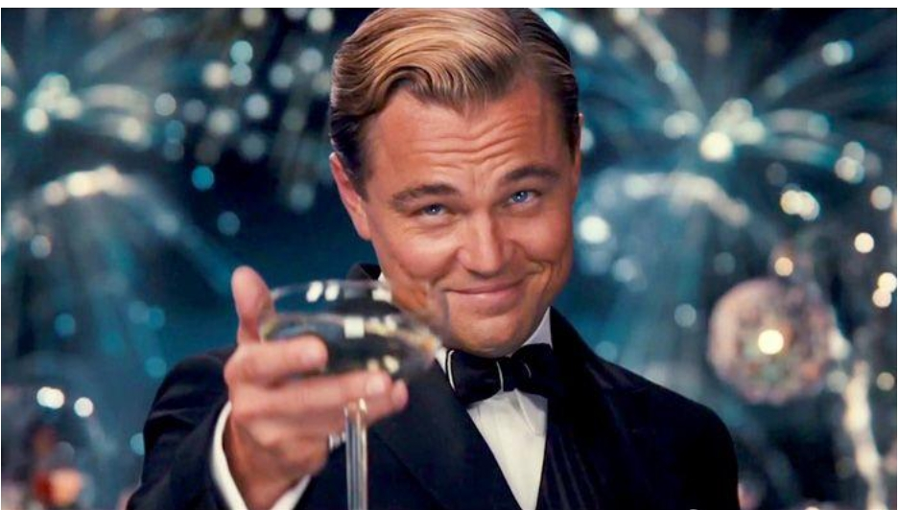
S
THANK YOU

